Slide 1
DSA-Project
Implementation of Matrix Bloom Filters and Trie-Maps in Email Analysis

Slide 2
Introduction
(Problem Statement, Novelty)

Slide 3
Problem Statement
In this DSA project we aim to create a model which can classify an email as Spam or Not Spam with the help of encryption algorithms and data structures.
This model is similar to that of a Machine Learning Model, but is more hyper specific to ONLY categorizing spam emails on the basis of factors like:
Domain of the sender’s email
Actual contents of the email (comparing with dataset of spam emails)

Slide 4
Novelty
What makes our project creative and innovative are the following factors:
Use of Matrix Bloom Filters: Using bloom filters instead of ordinary Hash Maps makes this entire solution space efficient and decreases the overall computation load.
Implementing a classification model in a language like C instead of python makes the overall run time a lot quicker.
Storing dictionary of email keywords with their corresponding weightage in a Map data structure, implemented by modifying Trie Data Structure. (Trie Map)

Slide 5
Literature Survey

Slide 6
Literature Survey
Matrix Bloom Filter Implementation: https://ieeexplore.ieee.org/document/6036819
Trie for Storing Dictionary of Keywords: https://www.geeksforgeeks.org/implement-a-dictionary-using-trie/
Bitwise Encryption Methods (for Bloom Filter): https://github.com/B-Con/crypto-algorithms/blob/master/sha256.c

Slide 7
Dataset Analysis

Slide 8
Kaggle Dataset used:
Kaggle Spam Emails Dataset:
https://www.kaggle.com/datasets/venky73/spam-mails-dataset
List of spam Email Addresses: https://www.theadminzone.com/threads/list-of-spam-email-addresses.27175/

Slide 9
Methodology Used
(Divided into 4 phases)

Slide 10
Steps we took to Implement the Model-PHASE 1
Analyzing the data
Preprocessing it:
Removing Numeric values
Convert all alphabets to lowercase
Remove all special characters and punctuations
Create list of stopwords in C (with inspiration from popular NLP libraries like NLTK and spaCy)

Slide 11
Steps we took to Implement the Model-PHASE 2
Feeding the Matrix Bloomfilter with the list of registered spam email ID’s, splitting with respect to sender’s domain
Modulating Dimensions according to Bloomfilter accuracy performance metrics.

Slide 12
Steps we took to Implement the Model-PHASE 3
Create a Trie-Map data structure
Map the frequency of the keywords found in the spam email corpus
Load these words and their corresponding calculated weightages
Word weightages are calculated with a very simple method:
weightage=(frequency of occurrence of the keyword)/(corpus size)

Slide 13
Steps we took to Implement the Model-PHASE 4
Parse the contents of the preprocessed email word by word and add to the score of the current email.
On the basis of the email score analysis and the interquartile range, we can classify the email contents as a probable spam or not.

Slide 14
System Architecture
(Layout and Design)

Slide 15
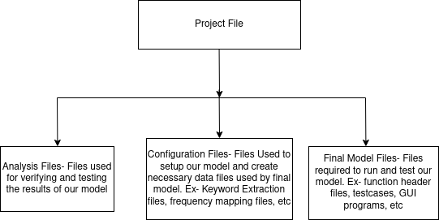
Layout of Program

Slide 16
Results and Validation

Slide 17
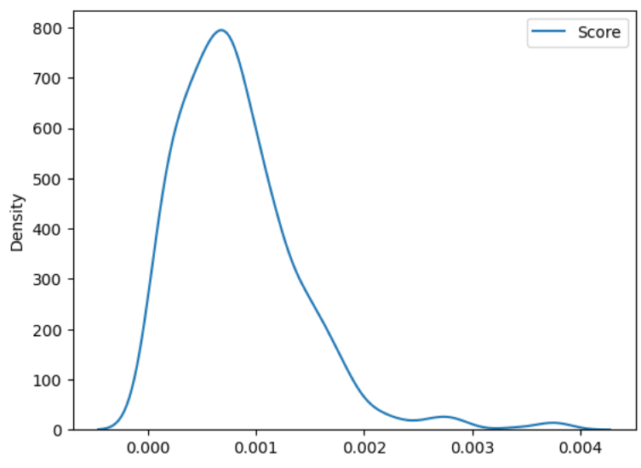
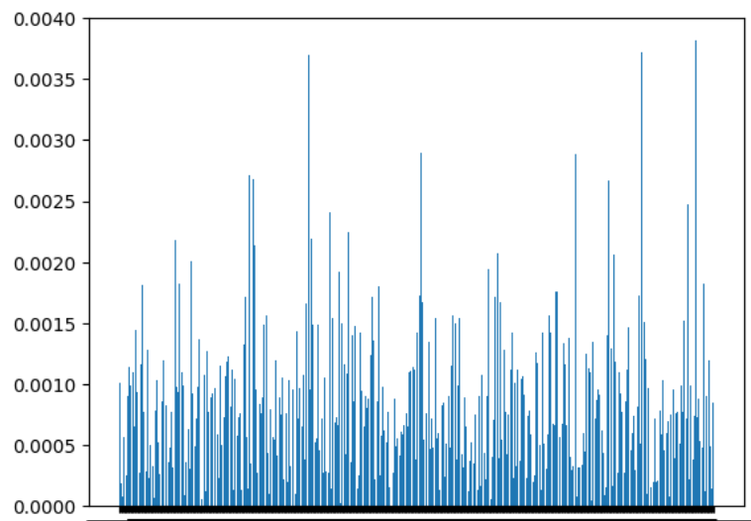
Email Scores

Slide 18
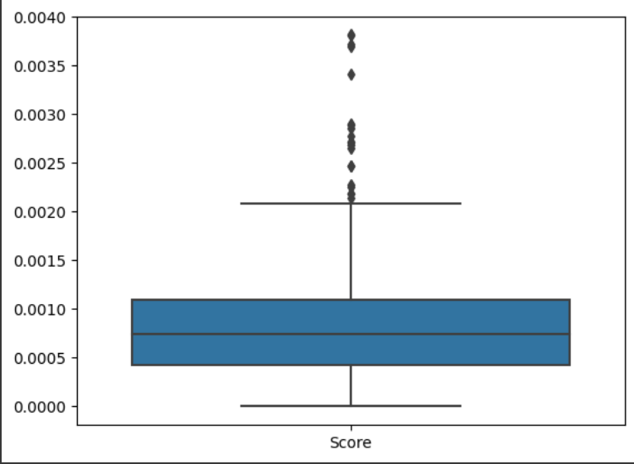
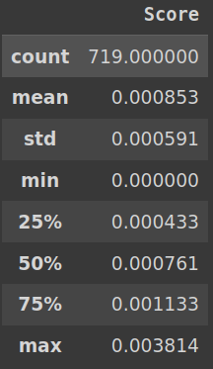

Slide 19
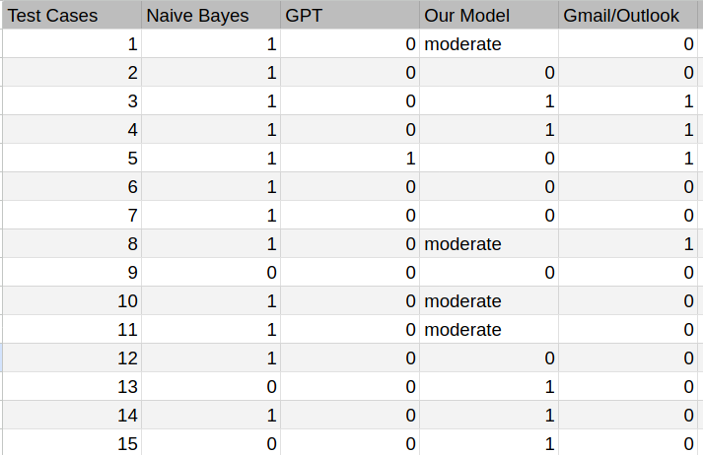
Except for a few outliers, our models behaves like the intermediate judgement between Naive Bayes and ChatGPT

Slide 20
Conclusion
Hence with the help of data structures like Tries, Bloom Filters and Maps, we have been able to create a simple but effective spam email analyzer.
This model has the run time and efficiency of C programming language and resembles something similar to an unsupervised ML
Avoids overfitting of model on data and creates a more generalized solution to email spam detection.

Slide 21
Future Scope
Implementing some form of hyper parameter tuning in C for determining Bloom Filter Model Dimensions
Implementing a powerful REGEX library in C for more effective email analysis and email preprocessing
Creating a model which uses other mathematical methods for analysing emails like Cosine Similarity, Word Embeddings, TF-IDF (in C)

Slide 22
Contributions
2D Bloom Filter Deployment: Atharva Mutsaddi and Aditya Choudhary
2D Bloom Filter Performance Testing : Aditya Choudhary
2D Bloom Filter Performance Analysis: Atharva Mutsaddi
Dataset Research and Preprocessing: Abhinav Kurule
Keyword Extraction: Abhinav Kurule and Atharva Mutsaddi
Map using Trie: Aditya Choudhary and Atharva M
Email Contents Analyzer with Trie-Map: Atharva M and Aditya Choudhary
Code Modularity- Abhinav Kurule
GUI Design- Abhinav Kurule
Final Model Integration- Abhinav Kurule, Atharva Mutsaddi, Aditya Choudhary
Results and Validation- Atharva Mutsaddi

